Slide 1
Capstone Project
ZOMATO RESTAURANT CLUSTERING AND SENTIMENT ANALYSIS
By
Akhilesh Kumar
Mentor: Richa Sharma
Date: 12.09.2021

Slide 2
Objective
Cluster the restaurants into segments.
Analyze the sentiments of the reviews given by the customer in the data and make useful conclusions in the form of visualizations.

Slide 3
Dataset Info
For Clustering
Name : Name of Restaurants
Links : URL Links of Restaurants
Cost : Per person estimated Cost of dining
Collection : Tagging of Restaurants w.r.t. Zomato categories
Cuisines : Cuisines served by Restaurants
Timings : Restaurant Timings
For Sentiment Analysis
Restaurant : Name of the Restaurant
Reviewer : Name of the Reviewer
Review : Review Text
Rating : Rating Provided by Reviewer
MetaData : Reviewer Metadata - No. of Reviews and followers
Time: Date and Time of Review
Pictures : No. of pictures posted with review

Slide 4
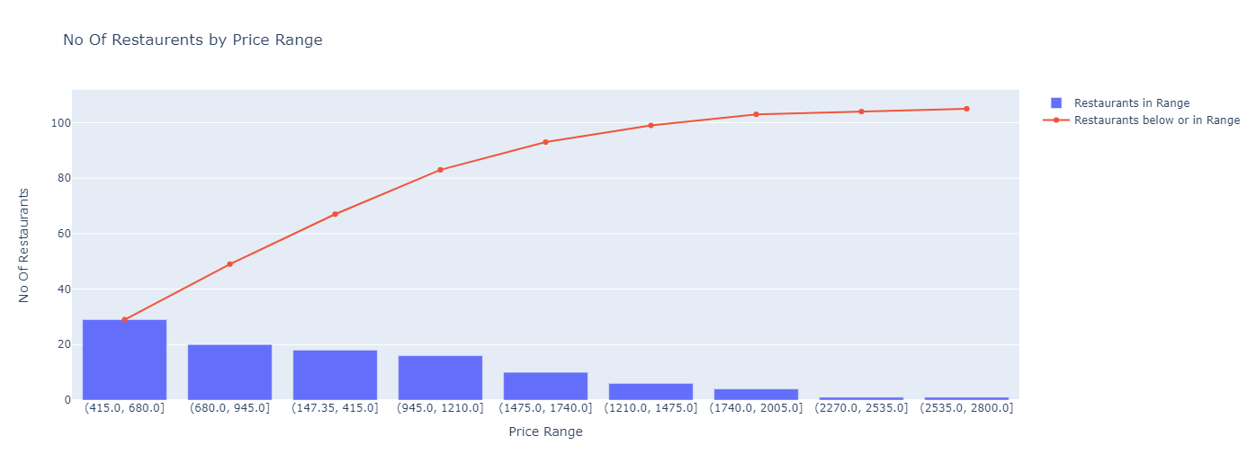
Overall Insight into Dataset

Slide 5
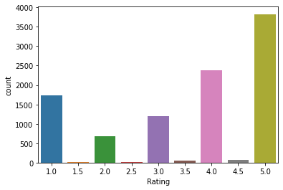
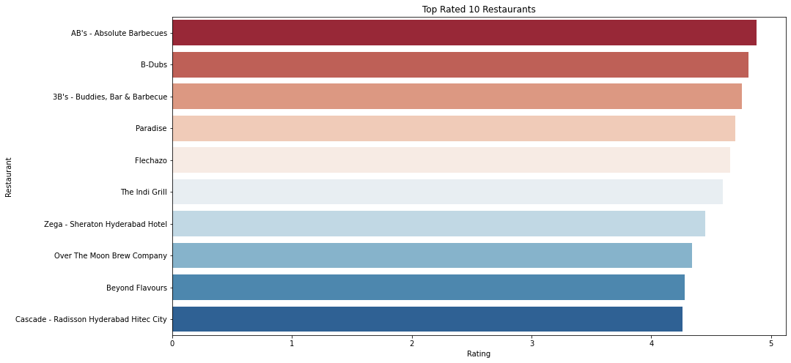
Overall Insight into Dataset ctd.

Slide 6
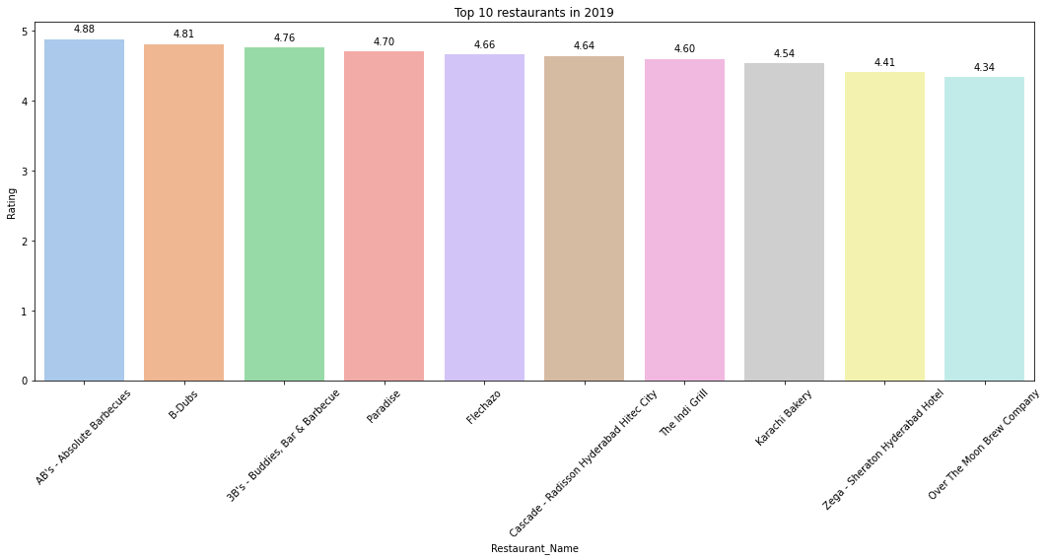
Overall Insight into Dataset ctd.

Slide 7
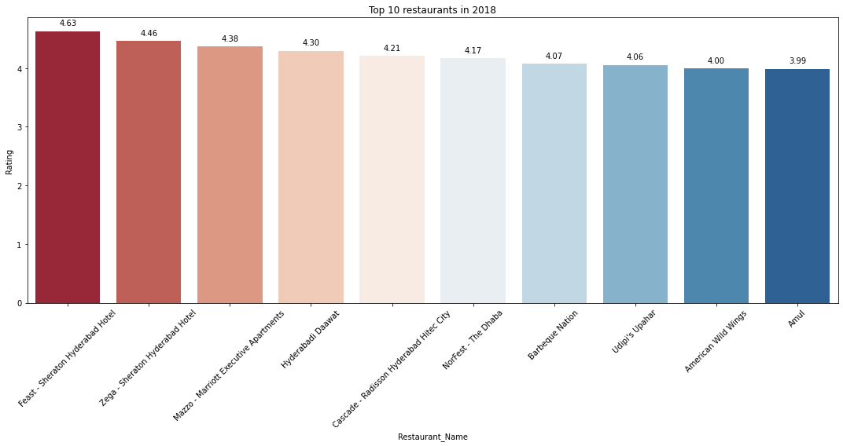
Overall Insight into Dataset ctd.

Slide 8
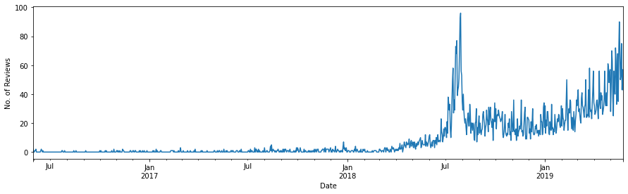
Overall Insight into Dataset ctd.

Slide 9
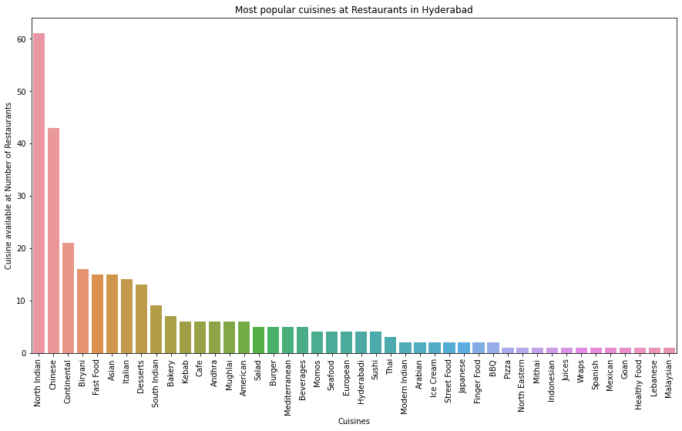
Overall Insight into Dataset ctd.

Slide 10
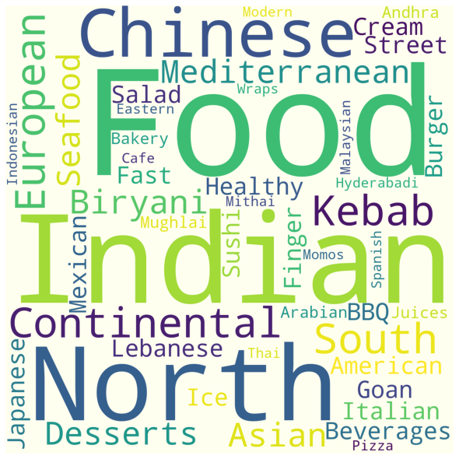
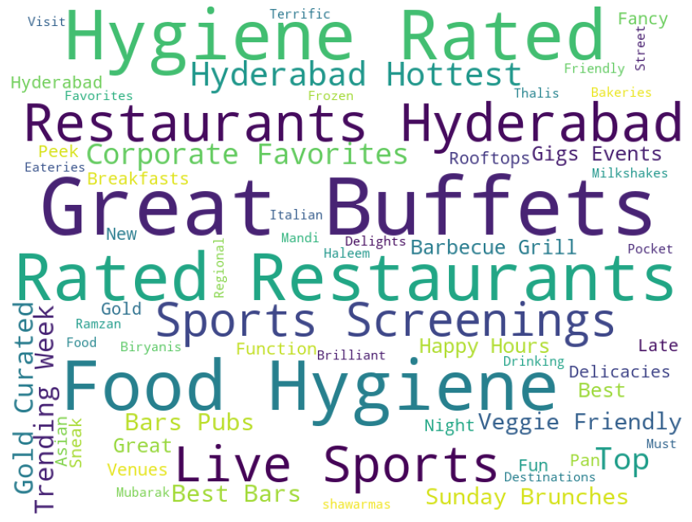
Wordcloud
Cuisines
Collections

Slide 11
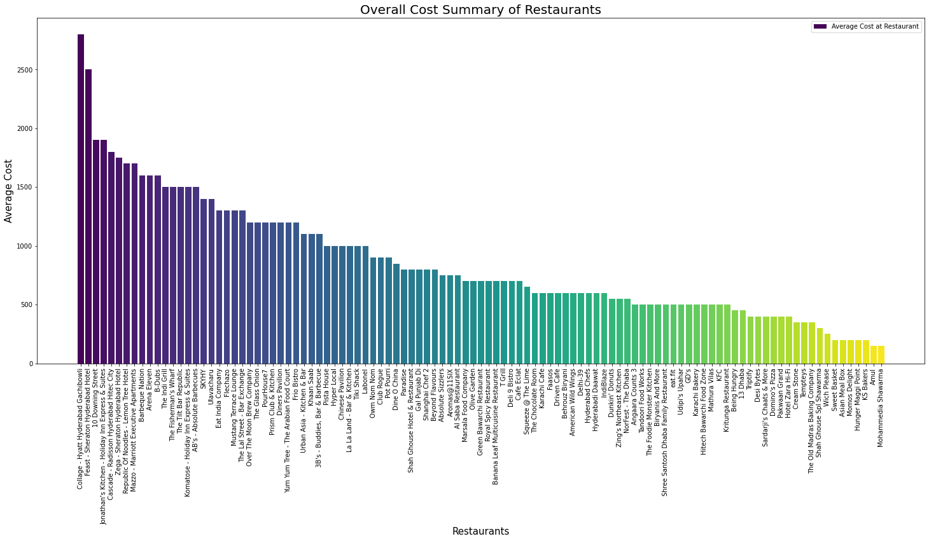
Overall Cost Summary of Restaurants

Slide 12
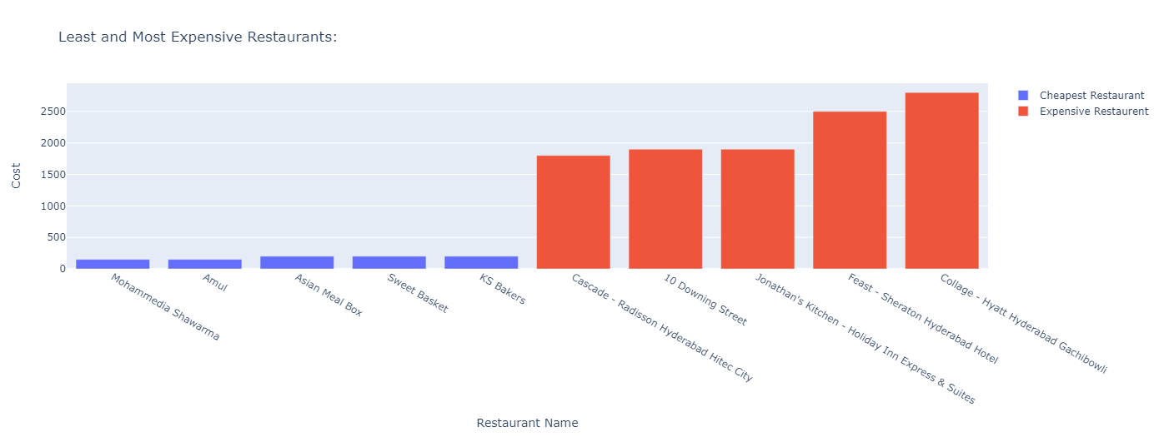
Least and Most Expensive Restaurants

Slide 13
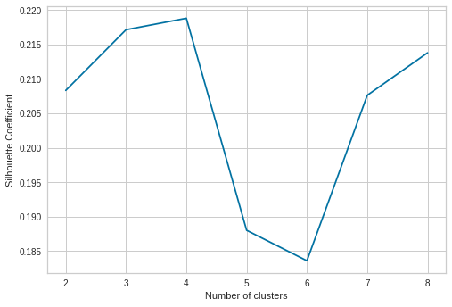
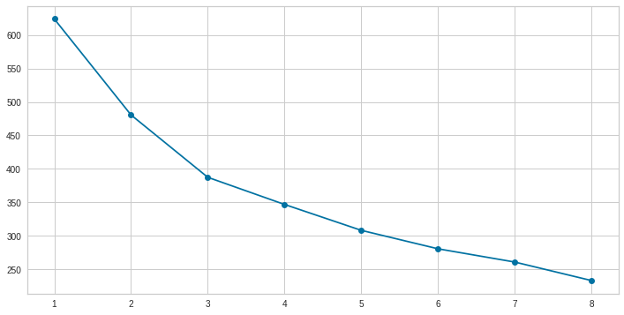
K Means Clustering plots
Silhouette score
Sum of squares elbow plot
From the Silhouette score plot, we can see that the optimum number of clusters is 4, and from the elbow plot we can see that the optimum number of clusters is 3.

Slide 14
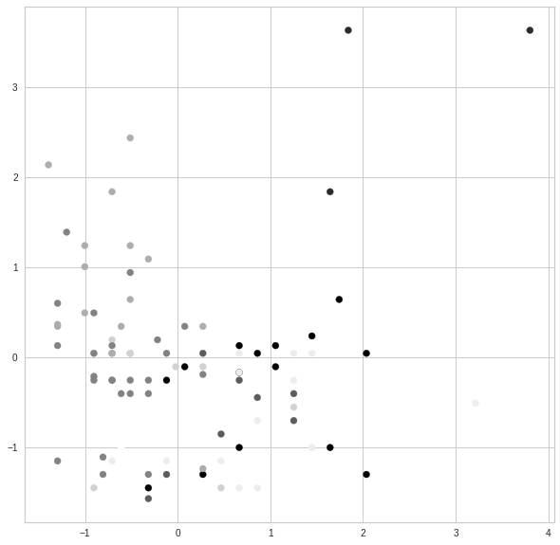
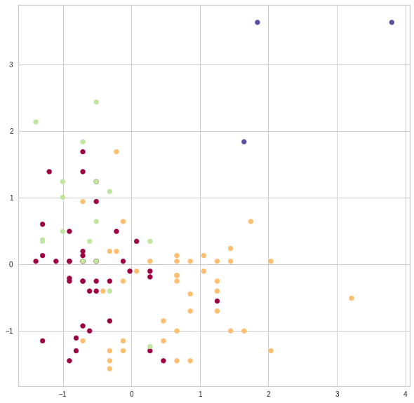
Cluster Visualization
No.of clusters - 3
No.of clusters - 4

Slide 15
Cuisines in different clusters
Cluster 0
Cluster 2
'north indian', ' chinese', ' continental', 'mediterranean', ' european', 'european', ' north indian', ' seafood', ' biryani', 'hyderabadi', 'continental', 'american', 'biryani',
' south indian', ' andhra', 'mediterranean', ' kebab', ' bbq',
'chinese', ' italian', ' asian', ' mughlai', ' beverages',
'modern indian', 'asian', ' desserts', ' spanish', ' japanese',
' salad', ' sushi', 'andhra', 'italian', 'mexican', 'kebab',
'thai', ' malaysian', ' thai', ' indonesian', 'seafood', ' goan',
'bbq', ' modern indian', ' finger food', 'healthy food'
'north indian', 'continental', 'american', ' chinese', 'american',
' fast food', ' salad', 'burger', ' biryani', 'mughlai', 'asian',
'mughlai', 'chinese', 'seafood', ' asian', 'momos', 'fast food',
'pizza', 'burger', 'continental', 'biryani', ' north indian',
'hyderabadi', ' japanese', 'sushi', 'finger food', ' kebab',
'arabian', 'south indian', 'street food', ' arabian', 'momos',
'lebanese', ' andhra', 'thai', 'north eastern'
Cluster 1
'ice cream', ' desserts', 'cafe', ' bakery', ' continental',
' fast food', ' beverages', 'desserts', ' cafe', ' burger',
'fast food', ' biryani', 'bakery', ' north indian', ' mughlai',
' juices', ' chinese', ' mithai', 'american', ' wraps'

Slide 16
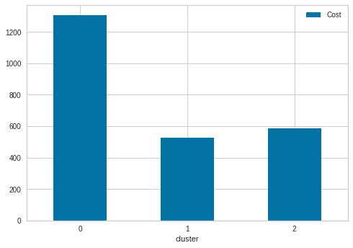
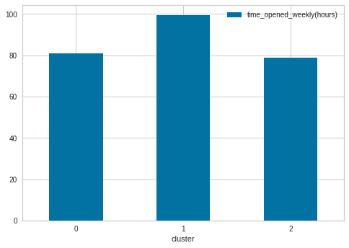
Average Cost and Time in three different clusters
We are not able to draw any conclusion after classifying into three clusters. So we have done the clustering into 4 groups as indicated by Silhouette score.

Slide 17
Cuisines in different clusters
Cluster 0
Cluster 1
Cluster 2
'north indian', ' chinese', 'continental', ' mediterranean', 'european', ' north indian', ' seafood', ' biryani',
' hyderabadi', 'continental', 'american', 'biryani',
' south indian', ' andhra', 'mediterranean', ' kebab', 'bbq',
'chinese', ' italian', ' mughlai', ' beverages', 'modern indian', 'asian', 'desserts', ' spanish', ' japanese', ' salad',
' sushi', 'andhra', 'mexican', 'kebab', 'thai', ' malaysian',
' thai', ' indonesian', 'italian', 'seafood', ' goan', 'bbq',
' modern indian', ' finger food', 'healthy food'
'ice cream', ' desserts', 'cafe', 'bakery', ' continental',
' fast food', ' beverages', 'desserts', ' cafe', ' burger',
'fast food', ' biryani', 'bakery', ' north indian', 'mughlai',
' juices', ' chinese', ' mithai', 'american', ' wraps'
'north indian', 'continental', 'american', ' chinese', 'american',
'fast food', ' salad', ' burger', ' biryani', ' mughlai', 'asian',
'mughlai', 'chinese', ' seafood', ' asian', ' momos', 'fast food',
' pizza', 'burger', 'biryani', ' north indian', 'hyderabadi',
' japanese', ' sushi', 'finger food', ' kebab', 'arabian',
'south indian', 'street food', ' arabian', 'momos', ' continental',
'lebanese', ' thai', 'north eastern'
Cluster 3
'north indian', ' italian', 'continental', ' asian',
'continental', ' north indian', ' chinese', 'italian',
' south indian'

Slide 18
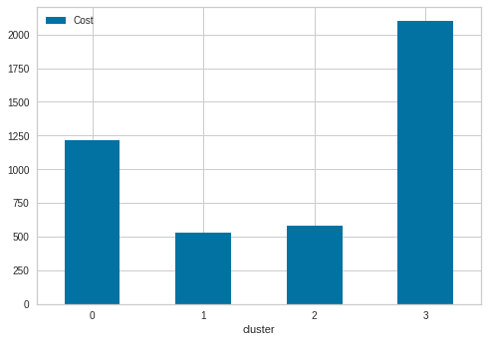
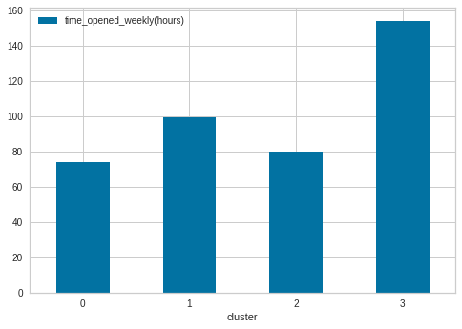
Average Cost and Time in four different clusters
We can say that restaurants that are open most of the time are relatively costlier.

Slide 19
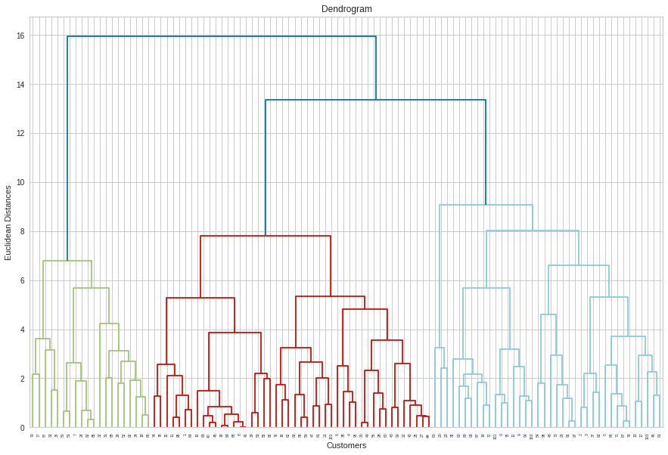
Dendrogram for Hierarchical clustering

Slide 20
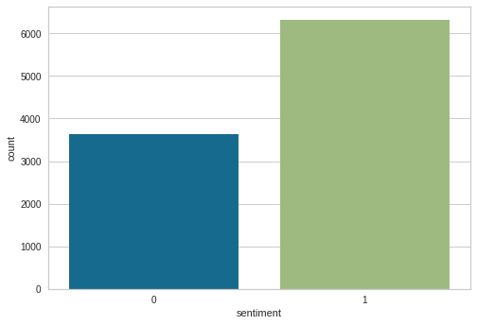
Sentiment Analysis
Ratings greater than or equal to 3.5 are classified as 1 (Positive sentiment), others as 0 (Negative sentiment)

Slide 21
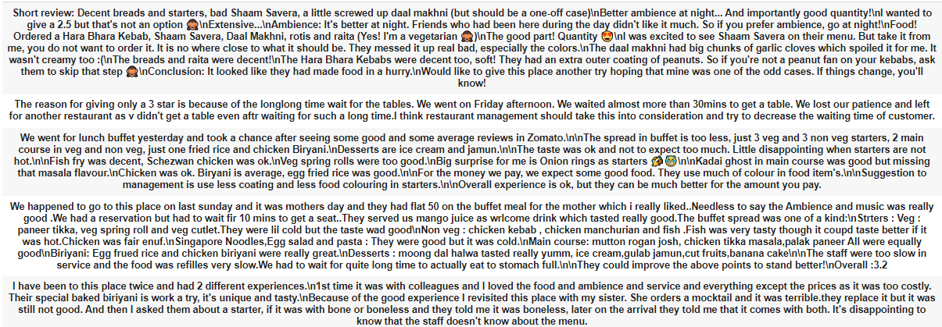
Sentiment Analysis ctd.
Special characters, emojis and stop words in the data were removed

Slide 22
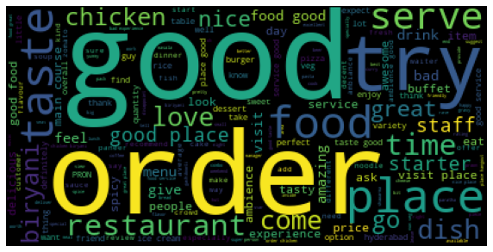
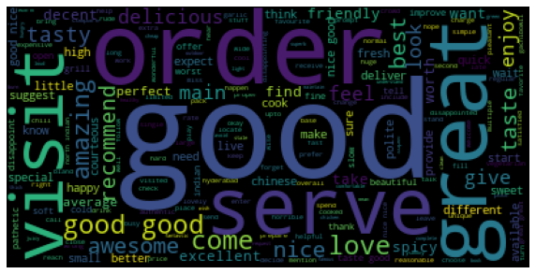
Word cloud for Reviews
Overall word cloud of review features
Adjectives and verbs
For reducing the dimensionality, adjectives and verbs were included as features

Slide 23
Performance metrics for diff. models (training set) - (TF-IDF vectorizer)
Algorithm | Class label | Performance parameters
 |  | Accuracy | Precision | Recall | F1 score
Multinomial NB | 0 | 0.84 | 0.90 | 0.63 | 0.74
 | 1 |  | 0.82 | 0.96 | 0.88
Logistic Regression | 0 | 0.85 | 0.75 | 0.90 | 0.82
 | 1 |  | 0.93 | 0.83 | 0.88
Decision trees | 0 | 0.79 | 0.73 | 0.66 | 0.69
 | 1 |  | 0.82 | 0.86 | 0.84
Random Forest | 0 | 0.74 | 0.59 | 0.95 | 0.73
 | 1 |  | 0.75 | 0.62 | 0.75

Slide 24
Performance metrics for diff. models (test set) - (TF-IDF vectorizer)
Algorithm | Class label | Performance parameters
 |  | Accuracy | Precision | Recall | F1 score
Multinomial NB | 0 | 0.81 | 0.85 | 0.59 | 0.70
 | 1 |  | 0.80 | 0.94 | 0.86
Logistic Regression | 0 | 0.80 | 0.69 | 0.85 | 0.76
 | 1 |  | 0.90 | 0.78 | 0.84
Decision trees | 0 | 0.79 | 0.70 | 0.63 | 0.66
 | 1 |  | 0.80 | 0.85 | 0.62
Random Forest | 0 | 0.70 | 0.55 | 0.90 | 0.69
 | 1 |  | 0.91 | 0.58 | 0.71

Slide 25
Performance metrics for diff. models (training set) - (Bag of words)
Algorithm | Class label | Performance parameters
 |  | Accuracy | Precision | Recall | F1 score
Multinomial NB | 0 | 0.86 | 0.84 | 0.75 | 0.80
 | 1 |  | 0.87 | 0.92 | 0.89
Logistic Regression | 0 | 0.85 | 0.75 | 0.90 | 0.82
 | 1 |  | 0.93 | 0.83 | 0.88
Decision trees | 0 | 0.77 | 0.67 | 0.71 | 0.69
 | 1 |  | 0.83 | 0.80 | 0.81
Random Forest | 0 | 0.77 | 0.63 | 0.95 | 0.75
 | 1 |  | 0.96 | 0.67 | 0.79

Slide 26
Performance metrics for diff. models (test set) - (Bag of words)
Algorithm | Class label | Performance parameters
 |  | Accuracy | Precision | Recall | F1 score
Multinomial NB | 0 | 0.83 | 0.79 | 0.72 | 0.75
 | 1 |  | 0.85 | 0.89 | 0.87
Logistic Regression | 0 | 0.81 | 0.69 | 0.85 | 0.76
 | 1 |  | 0.90 | 0.78 | 0.84
Decision trees | 0 | 0.75 | 0.66 | 0.67 | 0.67
 | 1 |  | 0.81 | 0.81 | 0.81
Random Forest | 0 | 0.72 | 0.58 | 0.89 | 0.70
 | 1 |  | 0.91 | 0.63 | 0.74

Slide 27
Challenges
1) Number of data points as well as the number of features were low for the clustering dataset, because of which we have only 3 clusters out of it.
2) Converting Timings feature in meta_data for clustering is challenging as the same restaurant is open for different timings for different days of a week, we somehow converted it into the total number of hours.
3) Collection feature from meta_data has 54 null values and converting it into a useful feature for clustering is a big task, we thought of getting information using the link features, though for every restaurant we have to do it manually one by one, so we dropped the idea.
4) In the Sentiment Analysis we tried by reducing features using regularisation though it's causing overfitting, we did a different experiment, though the result remain the same.

Slide 28
Conclusion
The best model we found out is Logistic regression for sentiment analysis.
We can say that restaurants that are open most of the time are relatively costlier.
Getting 3 optimum number of clusters by using elbow analysis and 4 number of optimum clusters by using silhouette coefficients.
In our case 4 clusters were best to cluster the data.

Slide 29
Thank you

